Slide 1

TD Bank Strategy | Biz Jam 2026
Premium Migration & Personalized Loyalty Engine
Closing the Loyalty Value Gap through Human-Centric AI and Real-Time Engagement.
TEAM: HUMAN & SIMPLE | Kevin Hau, Ning Zhao, Hai Nguyen, Linda Savoia, Bhoomi Patel, Anthony D'Costa

Slide 2


Meet Sarah: The Face of the Gap
Sarah is an everyday TD customer striving to earn meaningful rewards on daily purchases.
•
The Challenge: Points accumulate too slowly to feel relevant.
•
The Friction: Traditional redemption lacks immediate, visible value at checkout.
•
The Sentiment: "I shop daily, but my loyalty rewards feel months away."

Slide 3




The Loyalty Value Gap Challenge
Delayed Value
Complex UX
Skewed Rewards
Customers wait months to feel rewarded, losing momentum and engagement early in the cycle.
Redemption lacks immediate, visible value at the Point of Purchase (POP) or checkout counter.
Value is heavily skewed toward premium holders, leaving the base segment largely inactivated.

Slide 4
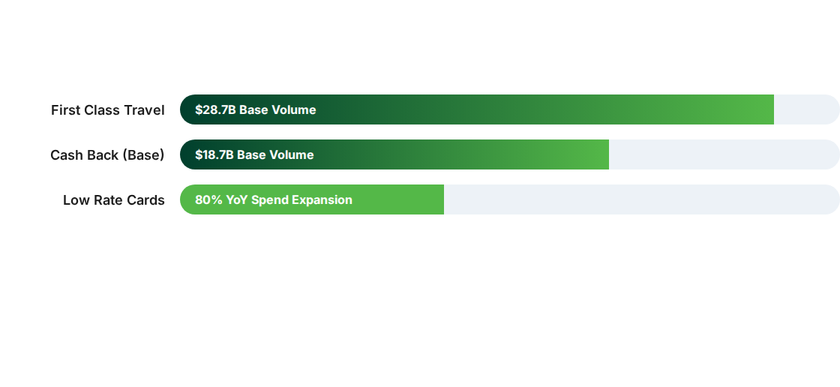
Current Performance Snapshot
Strategic Insight: Scale drivers ($28.7B) and growth engines (80% YoY) provide a massive pipeline for premium migration.

Slide 5
The Core Strategy
Shifting behavior from "Redemption-Only" to high-value "Spend + Redeem" cycles.

Slide 6


Tier Migration: Driving 3x Yield
Targeted Acceleration
We will migrate the top 10% of high-potential Cash Back users into Infinite tiers.
•
Realize 3x yield lift per active user.
•
Defend the $28.7B premium travel base.
•
Convert Low-Rate growth into a premium card pipeline.

Slide 7
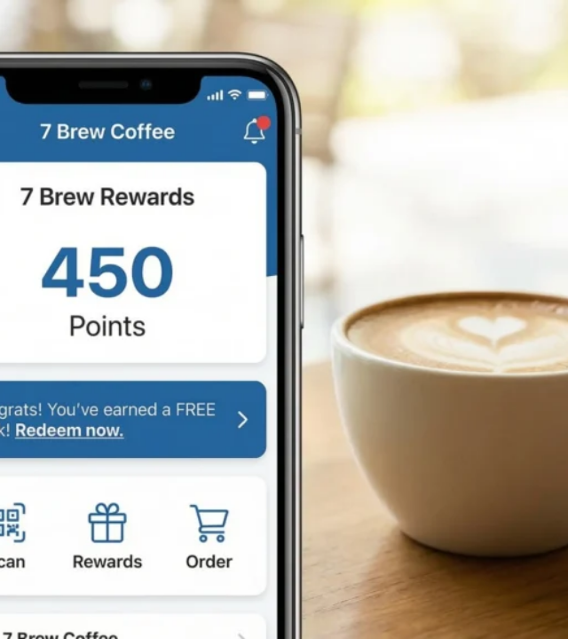
Sarah's Real-Time Experience
Humanizing the Technology
Our personalized loyalty engine recognizes Sarah's purchase intent in milliseconds.
The "Aha" Moment: Sarah swipes her card at Starbucks. Instantly, she gets a nudge: "Use 500 TD points to cover this $5.00 purchase right now?"
Simple. Immediate. Human.

Slide 8




The Four Pillars of Engagement
Personalized Nudges
Spend-Linked Rewards
Real-Time Redemption
Data-driven prompts to reactivate dormant accounts and increase monthly frequency.
Gamifying statements to unlock multipliers (e.g., hitting $1,500 spend unlocks 48hr boost).
Smart prompts at the Point of Purchase to drive point usage and perceived value.

Slide 9

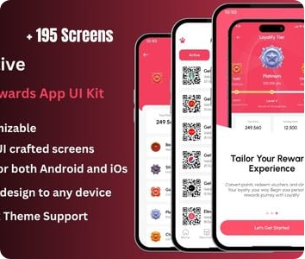

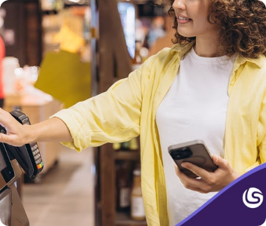

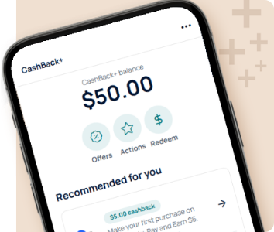
2026 Integrated Mobile Hub
Discover: Browse merchant offers integrated within EasyWeb.
Activate: Seamless integration with 30+ top retail brands.
Earn: Instant cash back and visible value accumulation.

Slide 10
Retention: High-Emotional Touchpoints
10%
2.4x
30+
ANNIVERSARY BONUS
LOYALTY LONGEVITY
MERCHANT BRANDS
Driving 10% annual bonus points on birthdays and anniversaries creates a personal connection that discourages card churn and builds long-term advocacy.

Slide 11
Scale Drivers & Projected Impact
Metric | Annual Target Impact | Strategic Benefit
Migration | +20K - 25K Monthly Users | Tiered yield lift and higher customer CLV.
Spend | +$1.68B Incremental | Captured "Spend + Redeem" high-value cycle.
Engagement | +15.7M Annual Actions | Mobile app stickiness and brand reinforcement.
Portfolio | 70% YoY Conversion | Securing the pipeline from base to premium.

Slide 12
Human & Simple
Questions?
Revolutionizing loyalty by putting Sarah at the center of every interaction.
2026 Biz Jam | A TD INVENT Challenge

Slide 13






Image Sources
https://dfjx2uxqg3cgi.cloudfront.net/img/photo/312381/312381_tt.jpg?20250621115012
Source: www.youworkforthem.com
https://png.pngtree.com/png-clipart/20250524/original/pngtree-elegant-golden-infinity-3d-design-on-black-background-for-conceptual-art-png-image_21069497.png
Source: pngtree.com
https://7brewmenuhub.com/wp-content/uploads/2025/12/Prompt_modern_coffee_2k_202512272251-1024x572.webp
Source: 7brewmenuhub.com
https://market-resized.envatousercontent.com/previews/files/654496869/inlinepreview.jpg?w=590&h=300&cf_fit=crop&crop=top&format=auto&q=85&s=5605b1a88e598f392bf982cf837cdc6ce3b628686d835365b0d577029cbbc87d
Source: codecanyon.net
https://www.lsretail.com/hs-fs/hubfs/Blog-Deliver-faster%2C-better-service-with-self-checkout-technology.jpg?width=826&height=413&name=Blog-Deliver-faster%2C-better-service-with-self-checkout-technology.jpg
Source: www.lsretail.com
https://www.sfcu.org/getContentAsset/334f9389-1dcc-42e4-8b06-39dd76cf5cdc/bd9e9f4d-9bd3-4fd9-b768-227495ff59c1/Cards-6-CashBack-Gift-Cards-Detail-Banner-445x624-v2.png?language=en
Source: www.sfcu.org

